Slide 1
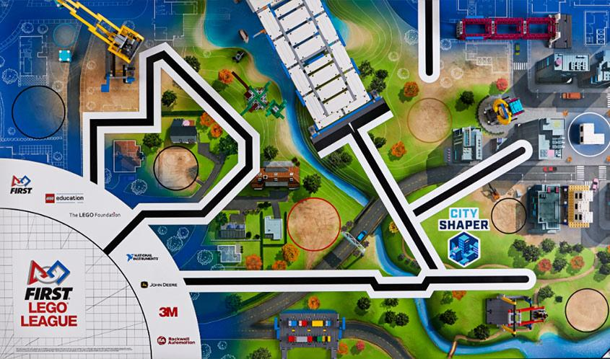
Dealing With Variability
FLL City Shaper NC Kickoff

Slide 2

About Me
My name is Davy Hallihan. I am a team #23236 (Space Whales) alumni and have been to two invitationals, Mountain State and Legoland. I am currently on FRC team Yeti #3506.

Slide 3
What is Variability
Our suppliers and volunteers try hard to make all Fields correct and identical, but you should always expect little defects and differences. Top teams design with these in mind. Examples include Border Wall splinters, lighting changes, and Field Mat wrinkles
Variability will be encountered at competition, and it can often throw off your robot runs. In this presentation I will be giving you methods to help deal with various aspects of variability.

Slide 4
Physical Methods

Slide 5
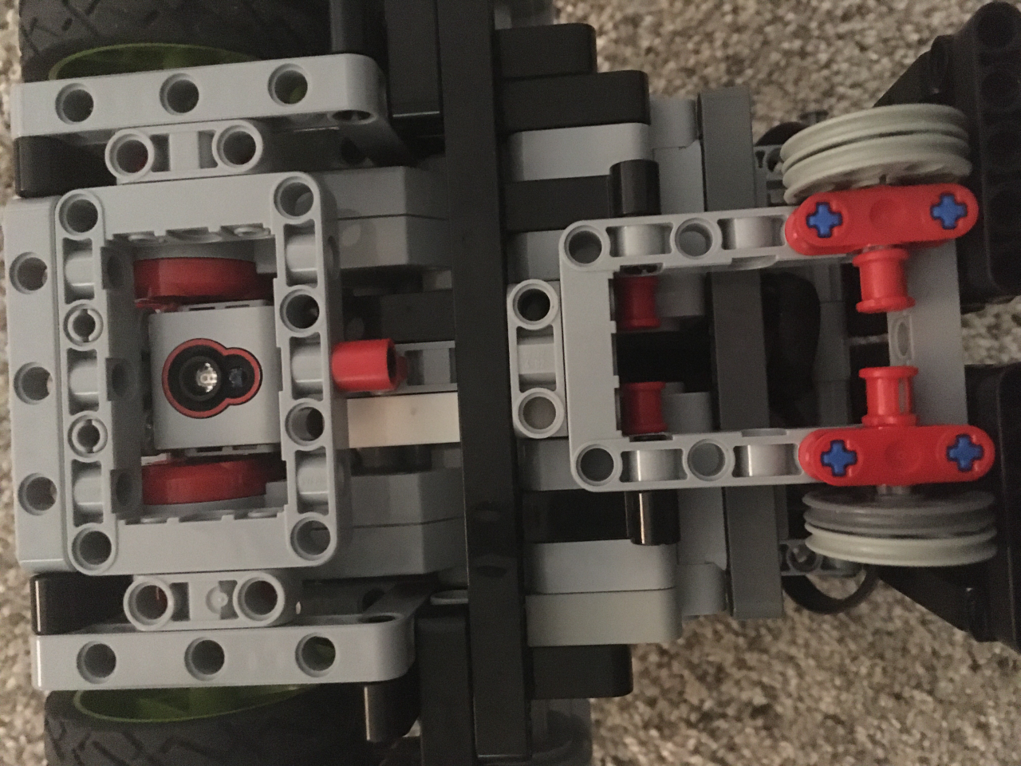
Color Sensor Shields
Color Sensors are very sensitive to light. In various competition settings, you can get different outputs. A physical way to deal with this is to shield your color sensor from outside light. This will prevent outside light interfering. For example, at North Carolina States, the overhead lighting is very bright and can cause readings to be closer to white than they are.

Slide 6
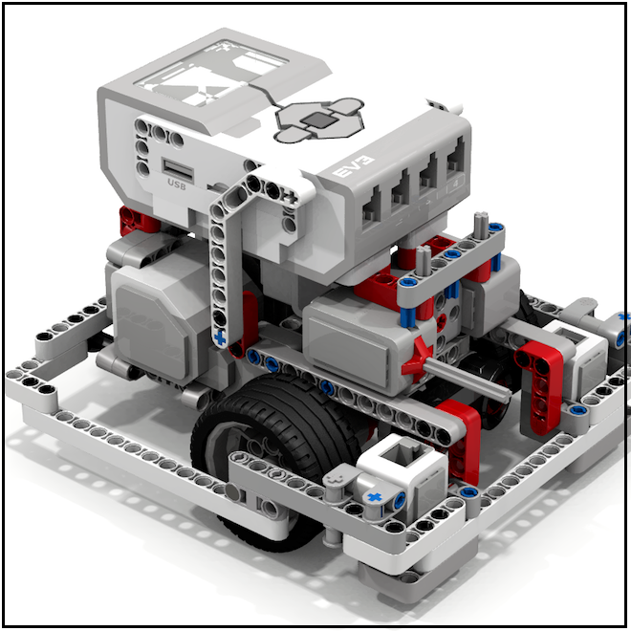
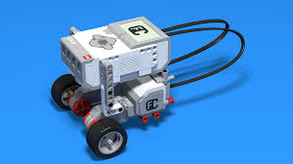
Flat Surfaces
If you make the back of your bot flat, you can back up at various places during your run to realign yourself. This gives you alignment points that can make sure your bot doesn’t get off track. While this may seem not very important, it helps deal with tables that are very slightly different sizes.
Good
Bad

Slide 7
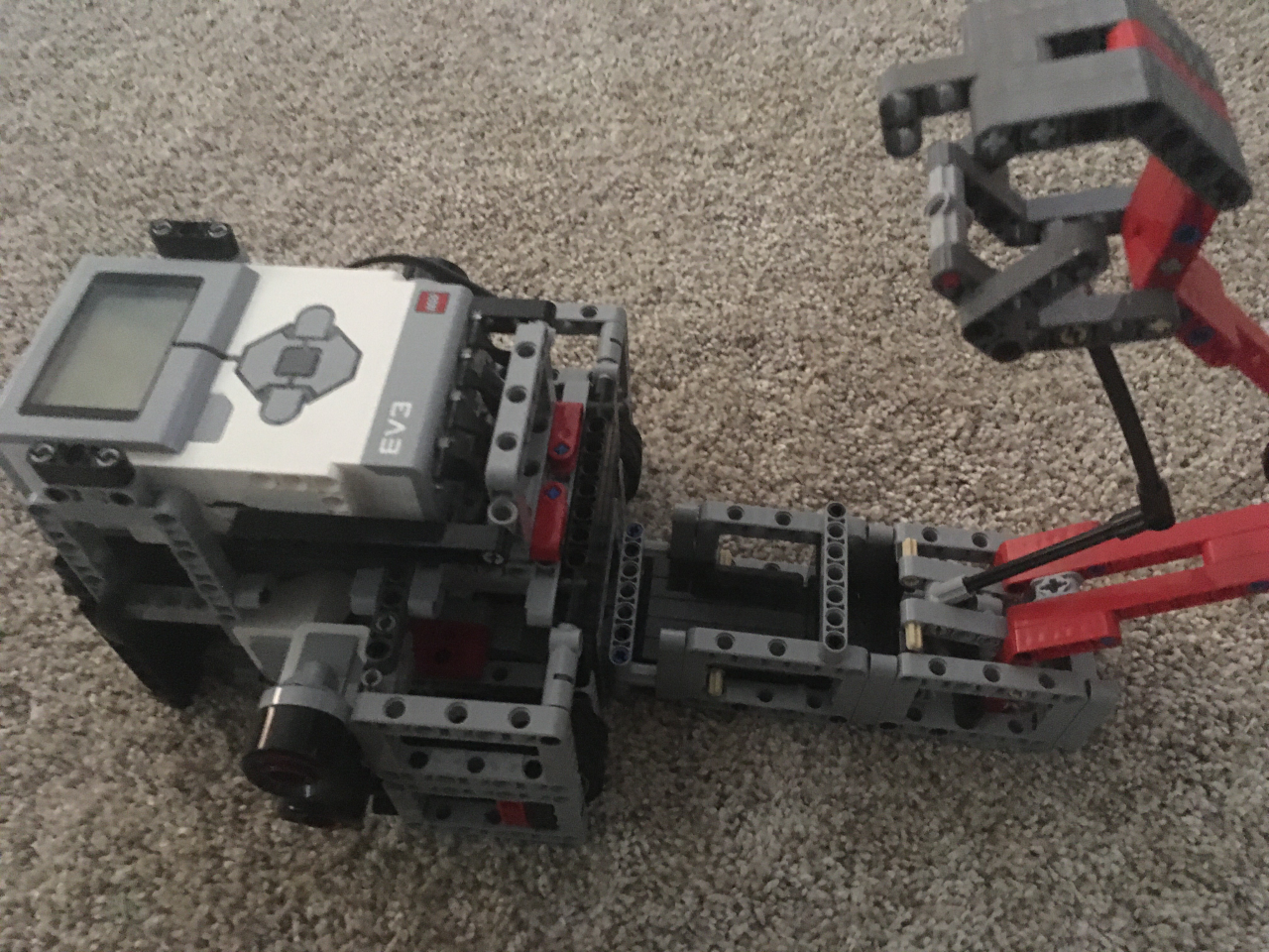
Aligning on Mission Models
By using Angles and Flat surfaces innovatively, you can align your robot on the mission model itself! This gives you the least variability on whether you complete a mission.

Slide 8
Programming Methods

Slide 9
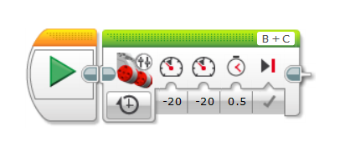
Using the Wall
At the beginning of each launch, your team members may press the bot against the wall differently. This can cause slight variation in how far the bot moves on it’s first movement. To fix this, simply have a “Reset” MyBlock that backs your bot up against the wall. In this MyBlock you can also easily add Variable resets and Sensor resets for your run.

Slide 10
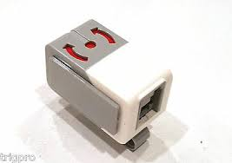
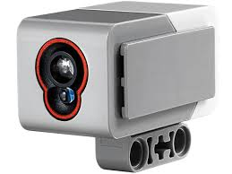
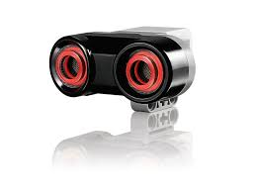
Sensor Use
Sensor use can help you massively with variability. Gyro sensors can detect your angle, making it so mat wrinkles don’t mess up geometric based turns. Color Sensors can align you on the mat (given that you deal with their light sensitivity). Ultrasonic sensors can put you a set distance from the wall. Make sure that you are using your sensors to their maximum capacity, removing variability in your run.

Slide 11
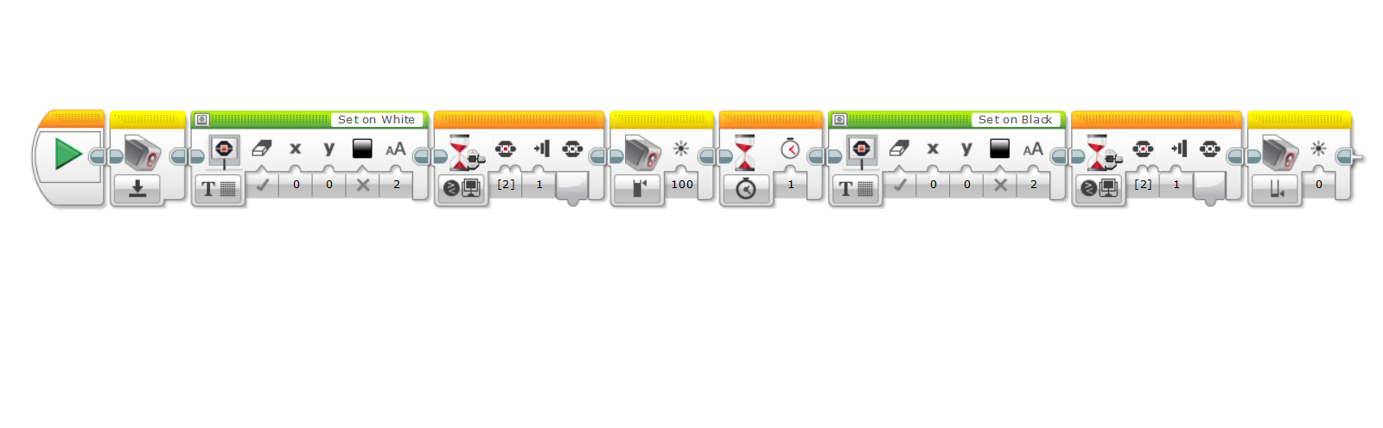
Color Sensor Calibration
This can help Calibrate your Color sensors to the environmental light around you. Shields in addition to this are preferred, but this should also work fine on it’s own. This short program just makes use of the Color Sensor calibration feature, setting white to maximum and black to minimum.

Slide 12
Color Sensor Use
There are two primary ways the Color Sensor is used in a match. The first is to follow a line, the second is to stop/align yourself on a line. I won’t detail these here, but Ev3 Lessons has great resources for these.

Slide 13
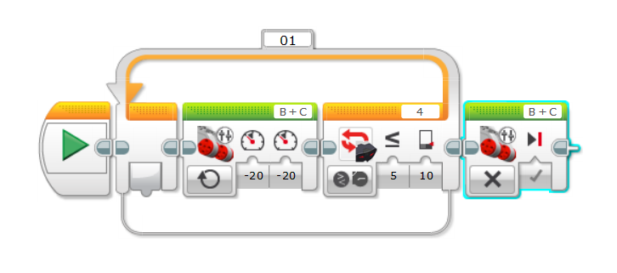
Ultrasonic Use
The Ultrasonic is one of the three most useful sensors. It also has a major advantage over the other two, and that is that it rarely needs calibration. Our team didn’t have a calibration block for it and it functioned perfectly. You can use the Ultrasonic to follow a wall (This program is incredibly complicated and involves trigonometry, so I won’t show it here), or simply to back up until you are __ distance from the wall.

Slide 14
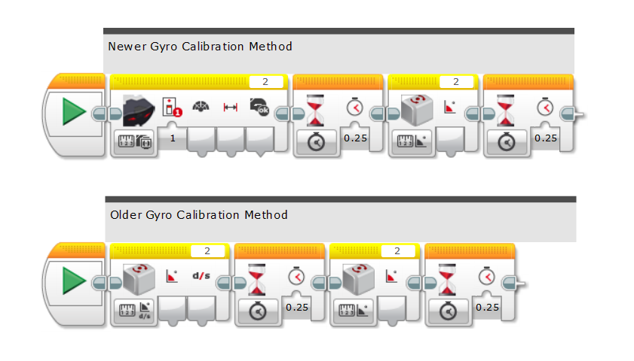
Gyro Calibration
In recent years, Gyros appear to becoming more and more reliable, but we still have to calibrate them to make sure we don’t get drift. You can calibrate it with the program below, but you should not need to calibrate it if you leave your robot perfectly still as you power it on, and don’t leave it on for hours at a time.

Slide 15
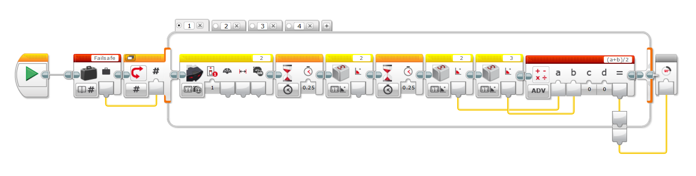
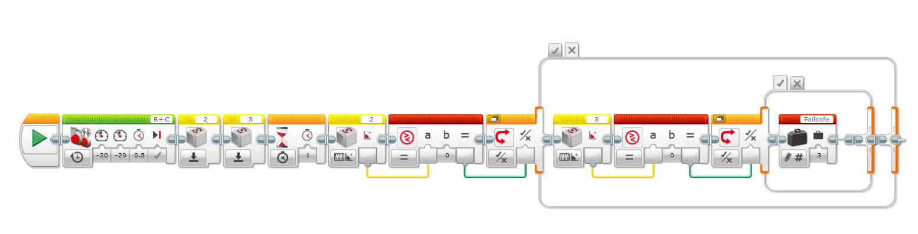
Gyro Failsafe
Our team, 23236, used a Gyro Failsafe to ensure that our Gyros never failed. We used two Gyro Sensors, and had a program that detected if either was drifting. If both were fine, we’d average them. If one was drifting, we’d use the other. If both were drifting, we’d reset them and wait 3 seconds (with the program shown in the previous slide).

Slide 16
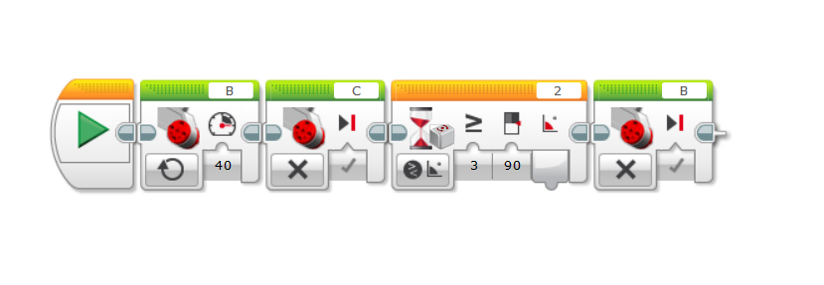
Gyro Moving and Turning
You can use your gyro for moving and turning, eliminating variability in angles due to wrinkles. You can have your robot turn until it has reached the angle desired, not having to rely on rotation count.

Slide 17
Link to Presentation
http://bit.ly/mcr-reliability

Slide 18
Questions?

